Slide 1
Interstitial Lung Disease (ILD)
Training Kit Target Audience: Primary Care Doctors in Malaysia (both public and private)
Trainers: Selected FMS, Chest Physicians and Rheumatologists in Malaysia In collaboration with
Disclaimer: This content is intended for medical professionals only.
This training material is intended solely for educational purposes. Unauthorized use or distribution is prohibited.
SC-MY-05412 Production Date: March 2025
Notes:
Speaker Notes:
Good [morning/afternoon], and thank you for joining us for this training on Interstitial Lung Disease (ILD).
Introduce self [NAME]
Today, our goal is to equip you with the skills to identify early ILD symptoms using case studies and to introduce the Referral Letter for Suspected ILD as a practical guiding tool.
By the end of this session, you’ll feel more confident in recognizing patients at risk of ILD and making timely referrals.

Slide 2
Content
Why an ILD Training Kit?
Overview of ILDs
Evaluating Patients for ILD
Practical Sessions
Referral Letter for Suspected ILD
Case Studies
Take ACTION: A Step-by-Step Guide to the Referral Letter for Suspected ILD
Summary
Acknowledgment
Notes:
Speaker Notes:

Slide 3
Why an ILD Training Kit?
Objective
This ILD Training Kit equips primary care doctors to identify, screen, and refer patients at risk of ILD.
How does this training help Primary Care Doctors?
Early detection: Helps you identify patients at risk of ILD early, enabling timely intervention and better patient outcomes.
Efficient referrals: Provides clear referral pathways to enable earlier diagnosis and improved care coordination.
Notes:
Speaker Notes:
The ILD Training Kit equips you with the knowledge and case-based learning to strengthen suspicion of at-risk ILD patients
It provides the tools to facilitate timely specialist referral, ensuring early intervention for better patient outcomes.

Slide 4
Overview of ILDs
What are ILDs?
Classification
Prevalence & Incidence
DALY & QALY
Interstitial Lung Diseases (ILDs) is a group of diseases that primarily affect the interstitium of the lungs.
Can result in progressive inflammation and irreversible scarring of the lung tissues, causing decreased lung capacity
Describes a collection of 200 lung diseases.
Examples include:
Idiopathic pulmonary fibrosis (IPF)
Connective tissue disease-associated ILD (CTD-ILD)
Exposure-related ILD
Others (Find out more about other ILD classifications here​.)
ILDs have a prevalence of 6.3-71.0 per 100,000 population, or up to 23,430 cases in Malaysia.
The incidence ranges from 1 to 31.5 per 100,000 person-years, estimating 330 to 10,395 new cases annually in Malaysia.
No DALY & QALY data available in Malaysia.
In 2019, ILDs are ~0.39% of the total Disability-Adjusted Life Years (DALYs) in the United States.
DALY: Disability-adjusted life year
QALY: Quality-adjusted life year
References:
Jeganathan, N., & Sathananthan, M. (2021). The prevalence and burden of interstitial lung diseases in the USA. ERJ open research, 8(1), 00630-2021. https://doi.org/10.1183/23120541.00630-2021
Kaul, B., Cottin, V., Collard, H. R., & Valenzuela, C. (2021). Variability in global prevalence of interstitial lung disease. Frontiers in Medicine, 8, 751181. https://doi.org/10.3389/fmed.2021.751181
An official American Thoracic Society/European Respiratory Society statement: Update of the international multidisciplinary classification of the idiopathic interstitial pneumonias. Am J Respir Crit Care Med. 2013 Sep 15;188(6):733-48. https://doi.org/ 10.1164/rccm.201308-1483ST.
Notes:
Speaker Notes:
ILD encompasses a group of disorders causing lung scarring and fibrosis.
Common symptoms include shortness of breath, dry cough, and fatigue.
Early symptoms often mimic common conditions like asthma or COPD, which can lead to delayed diagnosis.
Early intervention is crucial, as ILD progression is irreversible once scarring occurs.
ILD encompasses over 200 types of lung diseases characterized by scarring and inflammation of lung tissue.
Broadly classified into:
Idiopathic Pulmonary Fibrosis (IPF): Most common and severe.
Autoimmune-related ILD: Linked to conditions like rheumatoid arthritis or scleroderma.
Occupational or environmental ILD: Caused by exposure to substances like silica or asbestos.
To learn more about other ILD classifications, refer to An official American Thoracic Society/ European Respiratory Society statement: update of the international multidisciplinary classification of the idiopathic interstitial pneumonias.
The prevalence varies but is estimated to affect 86 per 100,000 people globally, with significant underdiagnosis in many regions.
The burden is high, leading to irreversible loss of lung function, reduced quality of life, and increased mortality if untreated.

Slide 5
Key Categories of ILD
Idiopathic Pulmonary Fibrosis
(IPF)
Connective Tissue Disease-Associated ILD
(CTD-ILD)
Exposure-related ILD
Chronic, progressive & of unknown cause
Occurs primarily in older adults
Defined by the histological and/or radiological pattern of usual interstitial pneumonia
Defined as evidence of ILD demonstrated by suggestive findings on HRCT scan of the lungs in the setting of an established CTD such as scleroderma or rheumatoid arthritis.
Arise from external noxious stimuli.
Can be divided into:
Occupational ILD: e.g., asbestosis, silicosis.
Environmental ILD: e.g., farmer’s lung, bird fancier’s lung.
Drug-induced ILD: e.g., ILD induced by methotrexate, amiodarone or nitrofurantoin.
References:
American Thoracic Society, 2018. Diagnosis of Idiopathic Pulmonary Fibrosis: An Official ATS/ERS/JRS/ALAT Clinical Practice Guideline.
H. Barnes and I. Glaspole. Occupational Interstitial Lung Disease. https://doi.org/10.1016/j.iac.2023.01.006
Vij, R., & Strek, M. E. 2013. Diagnosis and treatment of connective tissue disease-associated interstitial lung disease. Chest, 143(3), 814–824. https://doi.org/10.1378/chest.12-0741
American Thoracic Society. 2020. Connective tissue-related Interstitial Lung Disease Primer.
Schwaiblmair, M et al 2012. Drug induced interstitial lung disease. The open respiratory medicine journal, 6, 63–74. https://doi.org/10.2174/1874306401206010063
Notes:
Speaker Notes:
ILD can result from multiple causes: idiopathic, autoimmune conditions, occupational exposures, or drug toxicity.
Idiopathic Pulmonary Fibrosis (IPF) is the most common and aggressive subtype, requiring urgent attention.
Understanding these causes helps in recognizing and identifying patients at risk of ILD earlier.

Slide 6
Evaluating Patients for ILD

Slide 7
ILD History & Symptoms
Symptoms
Shortness of breath
Dry cough
Fatigue
Unexplained weight loss
Relevant
history
Relevant occupational history
Relevant environmental history
Suggestive of rheumatological disease
Other
history
History of cigarette smoking/ vaping
Past medical history
Family history of lung disease or autoimmune disease
Medication history
References:
Gogali, A., Wells, A.U. (2012). Diagnostic approach to interstitial lung disease. Curr Respir Care Rep 1, 199–207. https://doi.org/10.1007/s13665-012-0029-6
Notes:
Speaker Notes:
Overview: A high index of suspicion, guided by symptom persistence, history, and risk factors, is critical for early detection of at risk ILD patients and timely specialist referrals.
Key Symptoms:
Persistent dry cough and progressive shortness of breath are hallmark signs, particularly when they don’t respond to standard treatments. These symptoms often overlap with other conditions like asthma or COPD, which can delay diagnosis.
Fatigue or unexplained weight loss may further indicate underlying ILD in chronic cases.
Critical History Points:
Medical History: Consider autoimmune diseases like rheumatoid arthritis or systemic sclerosis.
Lifestyle and Occupation: Identify exposure to silica, asbestos, or other environmental risks.
Drug History: Be alert to medications linked to lung toxicity, such as amiodarone or methotrexate.
Guidance for Primary Care Physicians:
Focus on Red Flags: Persistent or progressively worsening symptoms should prompt further investigation and ensure timely specialist referrals.

Slide 8
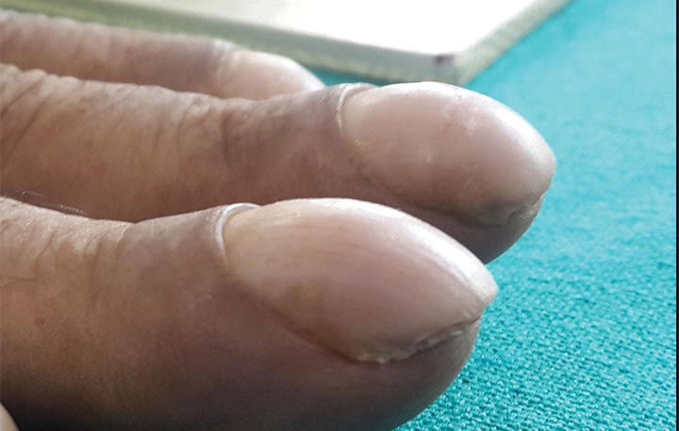
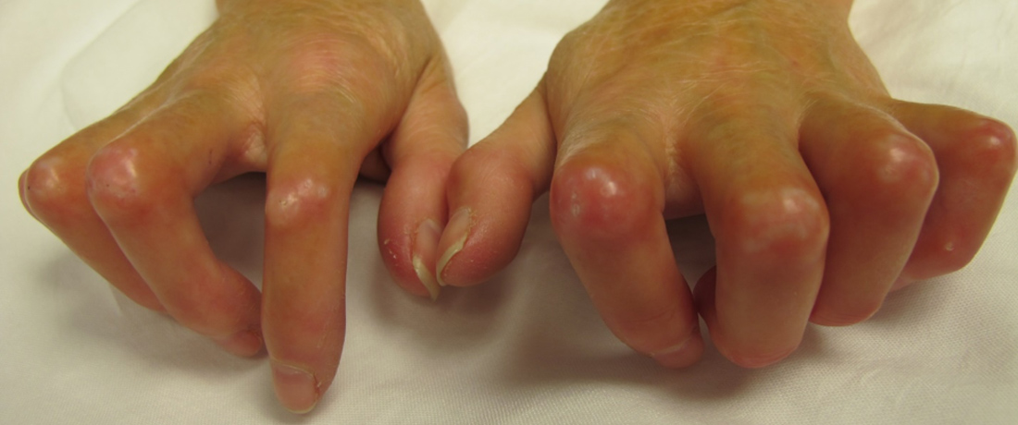
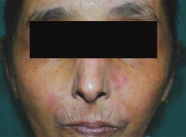
ILD Physical Examination
Fine “Velcro-like” inspiratory crepitations
Double click on icon to listen
Adapted from: Pulmonary Fibrosis 360 https://www.pulmonaryfibrosis360.com/pcp/suspecting-pulmonary-fibrosis/sound-the-alarm-for-the-sound-of-ILD
Finger Clubbing
Adapted from: Cleveland Clinic. Nail Clubbing. https://my.clevelandclinic.org/health/symptoms/24474-nail-clubbing
Signs of underlying connective tissue diseases, e.g., skin rashes, joint abnormalities
Adapted from:
1.Johns Hopkins Medicine, Clinical Connection. Scleroderma Lung Disease: The Best Protocol for Early Detection and Treatment.
2.Dave, Jayati. (2022). Cutaneous Features, Autoantibody Profile, and Nailfold Capillaroscopy of Systemic Sclerosis: A Study of 60 Cases. Journal of the Association of Physicians of India. 70. 24-31. 10.5005/japi-11001-0136.
Exercise-induced hypoxaemia
References:
Royal Australian College of General Practitioners (RACGP). Interstitial Lung Disease. An Approach to Diagnosis and Management.
Gogali, A., Wells, A.U. (2012). Diagnostic approach to interstitial lung disease. Curr Respir Care Rep 1, 199–207. https://doi.org/10.1007/s13665-012-0029-6
Behr, J. (2012). Approach to the Diagnosis of Interstitial Lung Disease. Clinics in Chest Medicine, 33(1), 1–10.
Notes:
Speaker Notes:
Look for fine "Velcro-like" inspiratory crackles during auscultation and physical signs like finger clubbing.
Other signs may include features of connective tissue disease, such as skin rashes or joint abnormalities.
Early physical findings can guide appropriate investigations.

Slide 9
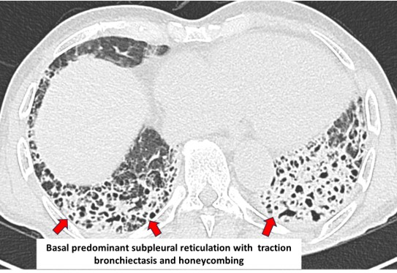
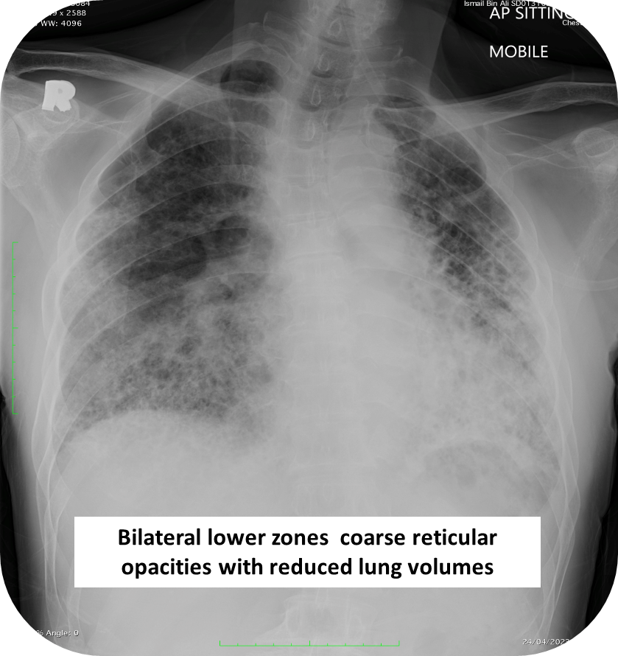
ILD Investigations
Tertiary centres
HRCT
(gold standard)
HRCT provides detailed imaging of lung scarring and patterns like honeycombing or ground-glass opacities, essential for differentiating ILD subtypes.
Secondary or
tertiary centres
Autoimmune markers
Positive in connective tissue disease
Primary care
centres
Chest Radiograph or
Lung Function Test
Chest X-rays often a starting point; can show reticular or ground-glass opacities but lacks the specificity of HRCT.
References:
Gogali, A., Wells, A.U. (2012). Diagnostic approach to interstitial lung disease. Curr Respir Care Rep 1, 199–207.
Notes:
Speaker Notes:
Overview: Strategic use of diagnostic tools is pivotal in confirming ILD, uncovering its underlying causes, and ensuring timely specialist referrals—empowering us to transform suspicion into precise, life-saving action
Chest X-rays: Often a starting point; can show reticular or ground-glass opacities but lacks the specificity of HRCT.
Lung Function Tests: Detect restrictive patterns characteristic of ILD, such as reduced Forced Vital Capacity (FVC).
Autoimmune Markers: Crucial for ruling in or out connective tissue diseases (e.g., ANA or RF positivity indicates autoimmune-linked ILD).
High-Resolution CT (HRCT): The gold standard for ILD diagnosis, HRCT provides detailed imaging of lung scarring and patterns like honeycombing or ground-glass opacities, essential for differentiating ILD subtypes.

Slide 10
Autoimmune Markers associated with Common CTDs
Connective Tissue Disease | Autoimmune Marker
Scleroderma | Antinuclear Antibody (ANA), Anti-centromere, Anti-Scl-70
Rheumatoid arthritis | Rheumatoid factor (RF), Anti-CCP
Systemic lupus erythematosus (SLE) | ANA, Anti-dsDNA, Anti-Sm
References:
Jog, N. R., & James, J. A. (2017). Biomarkers in connective tissue diseases. The Journal of Allergy and Clinical Immunology, 140(6), 1473-1483. https://doi.org/10.1016/j.jaci.2017.09.019
Notes:
Speaker Notes:
This slide highlights key autoimmune markers for common connective tissue diseases (CTDs), essential for diagnosis, monitoring, and treatment planning.
While these markers aid in differential diagnosis, clinical correlation and additional tests are often needed. Early detection and monitoring can improve disease management and patient outcomes.
Scleroderma: A rare autoimmune disease-causing skin and organ fibrosis.
Key markers:
Antinuclear Antibody (ANA): Common but nonspecific marker.
Anti-centromere: Strongly associated with limited cutaneous scleroderma (CREST syndrome).
Anti-Scl-70 (Topoisomerase I): More specific for diffuse scleroderma, linked to pulmonary fibrosis.
Rheumatoid Arthritis (RA): A chronic autoimmune disease affecting joints, causing inflammation and deformity.
Key markers:
Rheumatoid Factor (RF): Found in ~80% of RA patients but can appear in other conditions.
Anti-CCP (Cyclic Citrullinated Peptide): Highly specific for RA, often appearing before symptoms develop.
Systemic Lupus Erythematosus (SLE): A multisystem autoimmune disorder affecting skin, joints, kidneys, and more.
Key markers:
ANA: Present in nearly all SLE cases but also seen in other autoimmune diseases.
Anti-dsDNA: Highly specific for SLE, associated with kidney involvement.
Anti-Sm: Specific for SLE but found in a smaller percentage of patients.

Slide 11
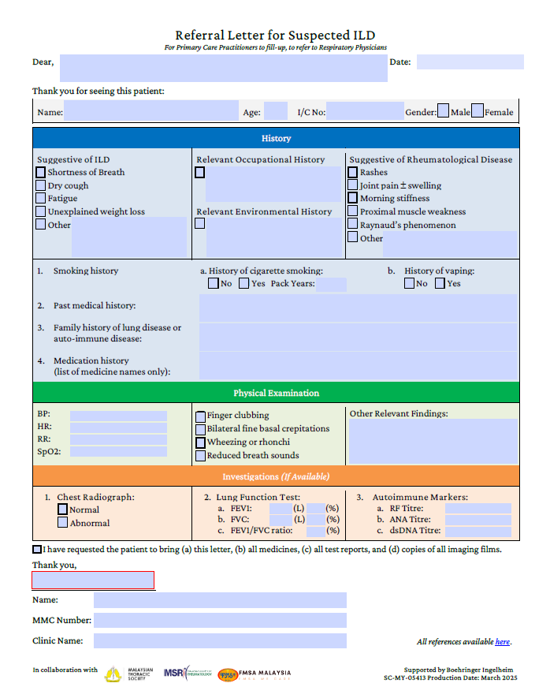
Please use the Referral Letter for Suspected ILD when you see…
Symptoms suggestive of ILD
Shortness of Breath
Dry Cough
Fatigue
Unexplained Weight Loss
and/or
Signs suggestive of ILD
Fine “Velcro-like” inspiratory crepitations
Finger clubbing
and/or
Investigations suggestive of ILD
Chest radiograph: reticular/ ground glass opacities
Lung function test: Restrictive pattern
Notes:
Speaker Notes:
Should you encounter signs, symptoms and test results that point to ILD - use the Referral Letter for Suspected ILD
The Referral Letter for Suspected ILD is a step-by-step tool to ensure no critical detail is overlooked.
It helps systematically document symptoms, risk factors, and investigation results.
Importantly, Referral Letter for Suspected ILD ensures timely and efficient referrals to specialists, improving patient care pathways.

Slide 12
Referral Letter for Suspected ILD
To access the Referral Letter for Suspected
ILD
Click here or,
Scan the QR code below.
Notes:
Speaker Notes
Ask Trainees to scan QR code to access online ILD Case Studies
Trainer will use case studies to guide Trainees to evaluate the cases and fill in the Referral Referral Letter for Suspected ILD as the cases are discussed.

Slide 13
Referral Letter for Suspected ILD Primary care physicians to use the Referral Letter for Suspected ILD to identify ILD risk and expedite referrals
1. Patient History and Symptoms
Patient History and Symptoms: Document key symptoms suggestive of ILD (e.g., shortness of breath, dry cough, fatigue) along with relevant occupational, environmental, and medical histories, including smoking and medication usage.
Physical Examination: Record vital signs, physical findings (e.g., finger clubbing, bilateral fine basal crepitations), and any other notable observations.
3. Provide Clear Referral Pathways
Complete the referral letter with patient details, attach all relevant reports, and guide the patient to bring necessary documents to the specialist appointment
2. Investigations
Include available test results such as chest radiographs, lung function tests, autoimmune markers while highlighting any abnormalities.
Notes:
Speaker Notes:
Step by step guidance on how to use Referral Letter for Suspected ILD
NB: If the appointment could be arranged by the referring clinic, this would greatly strengthen the referral pathway

Slide 14
A.C.T.I.O.N.: A Step-by-Step Guide to Use the Referral Letter for Suspected ILD
A
Assess symptoms and risk factors
Identify symptoms (e.g., progressive dyspnea, chronic cough).
Review patient history, lifestyle, and risk factors relevant to the condition.
C
Conduct relevant investigations
Perform preliminary diagnostic tests, such as lung function tests or HRCT scans, to gather necessary data.
Ensure the results meet criteria for referral.
T
Tick off the checklist
Complete the referral checklist systematically, documenting key symptoms, test results, and clinical findings.
Verify that all required sections are filled to avoid delays.
I
Initiate the referral
Submit the completed checklist to the specialist or referral center.
Attach supporting documents like test results for a comprehensive evaluation.
O
Orient and educate the patient
Explain the referral process, its importance, and what the patient can expect next.
Address any questions or concerns they may have.
N
Navigate follow-up (Optional but Important)
Track the referral to ensure timely feedback and continuity of care.
Facilitate ongoing communication between the patient and the specialist.
Notes:
Speaker Notes:
This structured approach turns the Referral Letter for Suspected ILD into a powerful tool for enhancing care coordination and ensuring its consistent use, all while focusing on patient outcomes. Let’s break it down:
A – Assess Symptoms and Risk Factors: Start by identifying key symptoms such as progressive dyspnea or chronic cough. Review the patient’s history, lifestyle, and any risk factors related to ILD.
C – Conduct Relevant Investigations: Perform necessary diagnostic tests, like lung function tests or HRCT scans, and make sure the results meet the referral criteria.
T – Tick Off the Checklist: Go through the checklist carefully, documenting essential symptoms, test results, and clinical findings. Make sure every section is filled to prevent delays in the process.
I – Initiate the Referral: Once the checklist is complete, submit it to the relevant specialist or referral center along with supporting documents such as test results for a thorough evaluation.
(NB: If the appointment could be arranged by the referring clinic, this would greatly strengthen the referral pathway)
O – Orient and Educate the Patient: Explain the referral process to the patient, clarify its importance, and walk them through what to expect next. Be sure to address any concerns or questions they may have.
N – Navigate Follow-Up: After the referral is made, it’s important to monitor the process, ensuring timely feedback and continuity of care. Maintain communication between the patient and specialist to keep everything on track.

Slide 15
ILD Case Studies
To access the online ILD Case Studies
Click here or,
Scan the QR code below .
Notes:
Speaker Notes
Ask Trainees to scan QR code to access online ILD Case Studies
Trainer will use case studies to guide Trainees to evaluate the cases and fill in the Referral Referral Letter for Suspected ILD as the cases are discussed.

Slide 16
Summary
Early detection and referral of at-risk of ILD are crucial for effective management.
The Referral Letter for Suspected ILD provides structured guidance to aid patient evaluation, investigations and referral decisions.
The case studies in this ILD Training Kit enhance physicians’ confidence in identifying and managing at-risk ILD cases.
Collaboration with specialists ensures continuity of care and better patient outcomes.
To access the BIILD Learning Program ILD Resources, click here

Slide 17
Acknowledgment to the ILD Expert Panel
Dr Syazatul Syakirin Sirol Aflah (Chair) Respiratory Physician Institut Perubatan Respiratori
Datin Dr Zuhanis Abdul Hamid Thoracic Radiologist Institut Kanser Negara
Prof Dr Roslina Abdul Manap Respiratory Physician Sunway University
Dr Aida Abdul Aziz Thoracic Radiologist Gleneagles Hospital Johor
Dr Noorul Afidza Muhammad Respiratory Physician Hospital Sultan Idris Shah Serdang
Dr Hema Yamini Devi A/P Ramarmuty Respiratory Physician Hospital Queen Elizabeth
Dr Teoh See Wie Family Medicine Specialist KK Salak
Dr Shereen Ch'ng Suyin Rheumatologist Hospital Selayang
Dr Maryem Sokhandan Fadakar Family Medicine Specialist KK Bandar Tun Hussein Onn

Slide 18
arc@angsanahealth.com

